Slide 1
Customer Churn Analysis
Predictive Analytics & Business Intelligence
Complete Analysis: Data Prep | EDA | Segmentation | Prediction | Recommendations

Slide 2
Dataset Overview
7,043
26.4%
20
4
Dataset Size
Overall Churn
Features Analyzed
Models Tested
Project Objectives
1. Analyze customer churn patterns in a telecommunications industry
2. Segment customers based on behavior and value
3. Develop predictive models to identify at-risk customers
4. Provide actionable business recommendations for retention

Slide 3
Task 1: Data Preparation
Dataset Overview
Data Cleaning
7,043 customer records
20 features including:
• Demographics 👤 (gender, senior citizen, Partner)
• Services 📱(internet, phone, streaming)
• Account info 📁 (tenure, contract, payment method)
• Financials 💰 (Charges)
• Target: Churn (Yes/No)
Missing values: TotalCharges column
For EDA:
✓ Removed duplicate records
✓ Handled missing TotalCharges (mean imputation)
For Model:
✓ Encoded categorical variables
✓ Split data: 80% train, 20% test
✓ Standardized numerical features

Slide 4
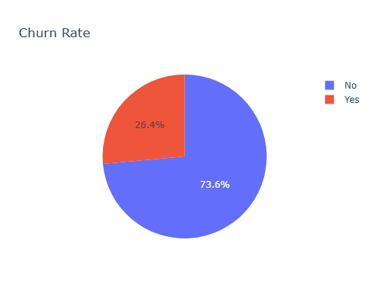
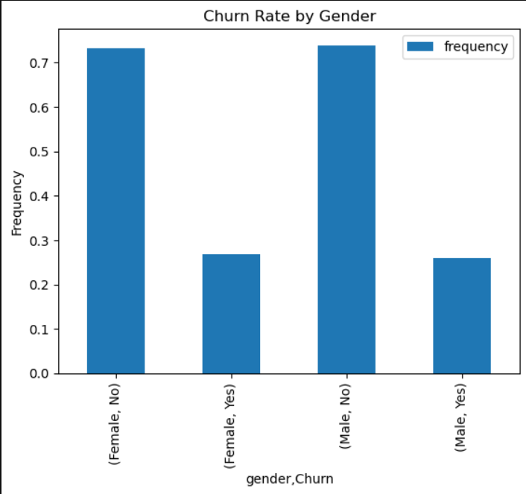
Task 2: Exploratory Data Analysis
Churn Rate (26%)
There is no significant difference between churn rates by gender.

Slide 5
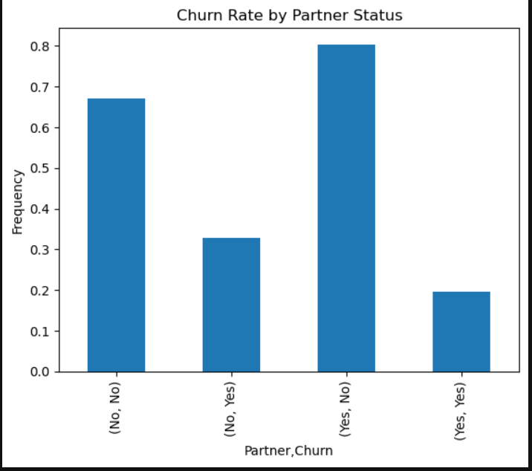
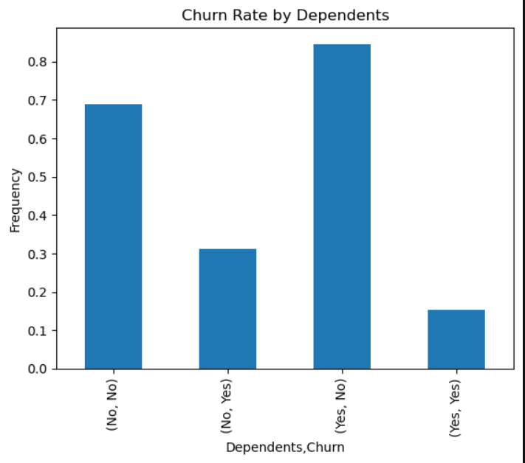
Churn Rate by Partner Status and Dependents
Churn Rate is higher customers who have no Partners and Dependents

Slide 6
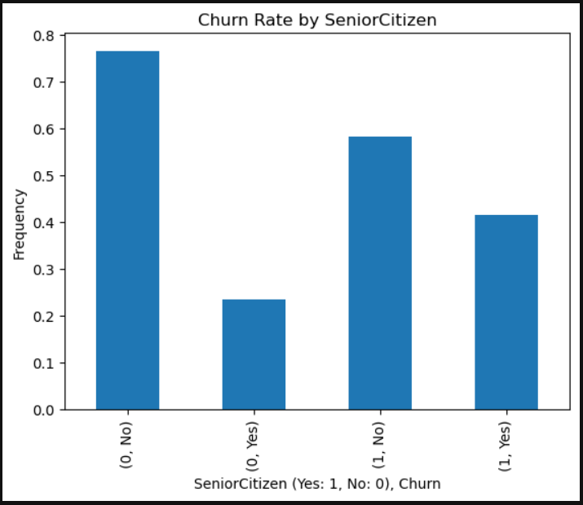
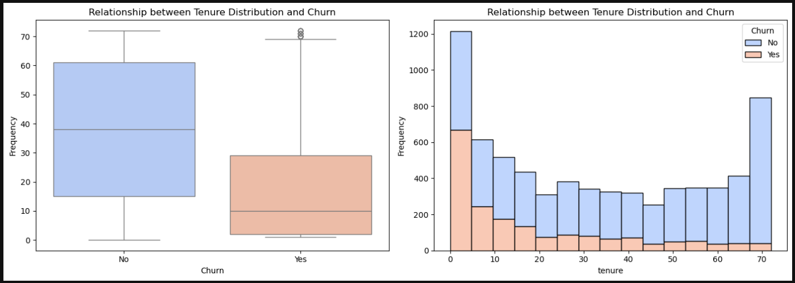
Churn Rate by Senior Citizen and Tenure Distribution
Churn seem higher among Senior Citizen
Customers who did not churn have a higher median tenure and broader tenure range, suggesting long-term customers are more stable and less likely to cancel.
Churned customers generally have lower median and shorter tenures. Mostly under 20 months, indicating newer customers are more likely to leave.
Churn frequency is highest among short-tenure customers and gradually decreases as tenure increases, while non-churned customers dominate the longer tenure ranges.

Slide 7
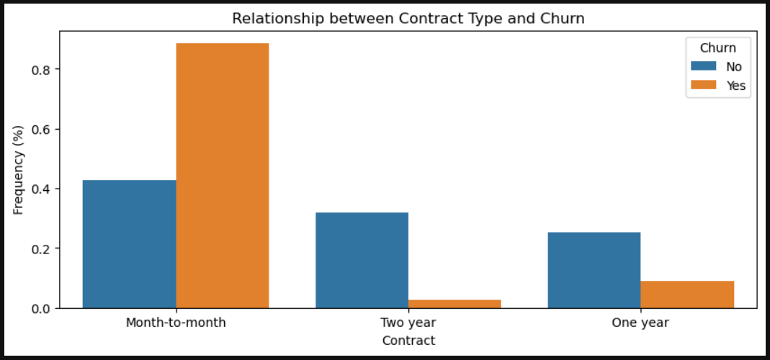
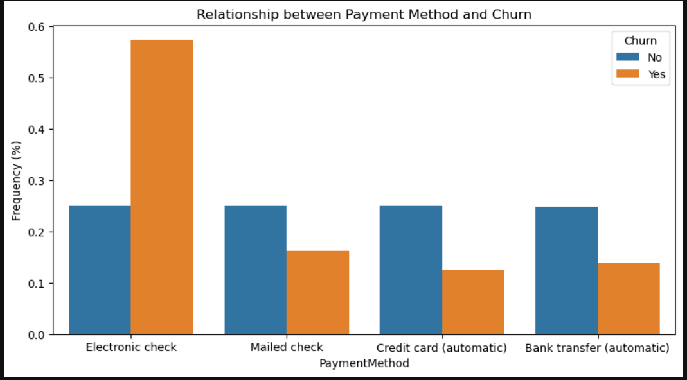
Churn Rate by Contract type and Payment Method
Customers on month-to-month contracts show the highest churn rate. This indicates that shorter contract durations and tenures are linked to higher customer attrition.
Churn rate is highest among customers who use the electronic check payment method

Slide 8
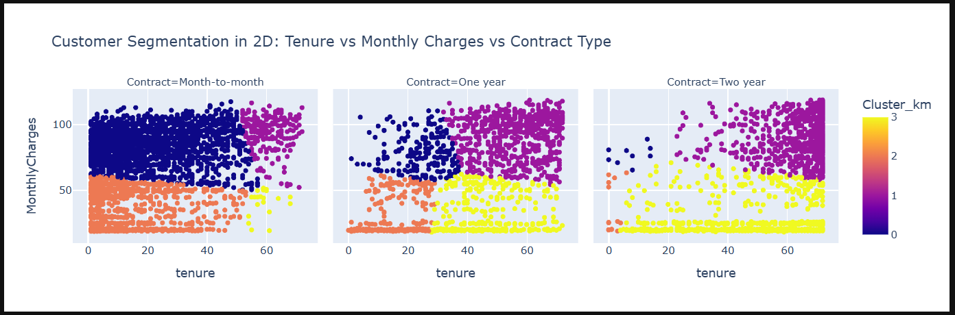
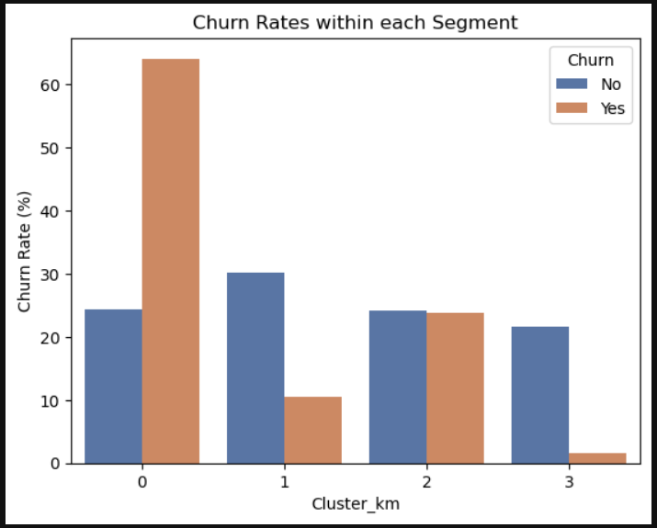
Customer Segmentation
Cluster 0 (Short Contract and Medium/High Charges): High Risk (Mostly in Month-to-Month Contract type).
Cluster 1 (Long Contracts and High Charges): Loyal Premium (Dominated in One- and Two-year Contract types).
Cluster 2 (Month to Month and Low Charges): New Low Spend (Dominated in short Contract types and low Monthly Charges).
Cluster 3 (Long Contracts and moderate Charges): Stable Long-Term

Slide 9
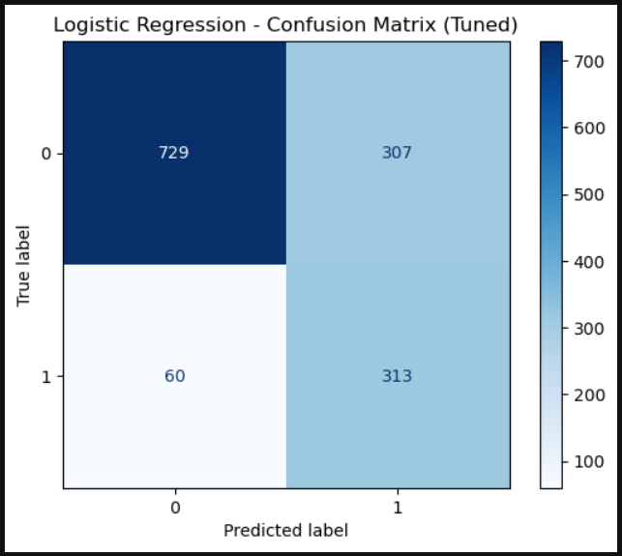
Predictive Modeling
Machine Learning Model Evaluated
Logistic Regression (ROC-AUC = 0.841)
Decision Tree (ROC-AUC = 0.784)
XGBoost (ROC-AUC = 0.819)
Random Forest (ROC_AUC = 0.819)
Logistic Regression model is chosen because of its high ROC-AUC and churn recall (better at catching churners) compared to other models.
 | Precision | Recall | F1 | Support
0 (No Churn) | 0.92 | 0.70 | 0.80 | 1036
1 (Churn) | 0.50 | 0.84 | 0.63 | 373

Slide 10
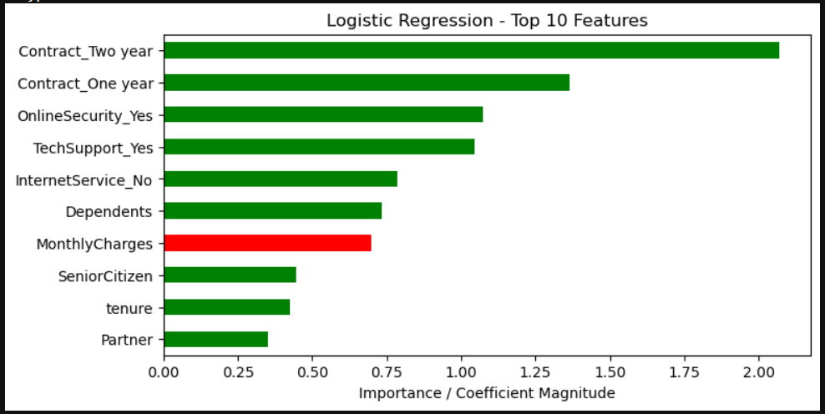
Top 10 Churn Predictors
Top churn driver: High Monthly Charges
Top retention drivers: long contracts, tech/security add-ons, dependents, tenure, senior citizen, etc

Slide 11
Model Insights & Interpretation
Price Sensitivity
💰
High monthly charges are the strongest churn predictor. Customers paying premium prices need exceptional value delivery.
Service Quality
📡
Offer protective Services to high-risk customers since these services lower churn risk
Contract
📦
Promote longer contract options to both new and existing customers

Slide 12
Task 6: Strategic Recommendations
A. Targeted Retention
Focus on Cluster 0 and month-to-month customers
Personalized offers for high monthly charge customers
Bundle promotions for fiber optic & streaming users
Contract upgrade incentives with added value
B. Customer Engagement
Proactive outreach to high-risk segments
Feedback collection from churn-prone groups
Incentivize autopay & credit card payments
Early warning system based on model predictions
C. Marketing & Product
Win-back campaigns for recent churners
Referral programs leveraging Cluster
Service quality improvements for fiber optic
Simplify add-on services & improve value perception

Slide 13
Key Takeaways
✓ 26.4% churn rate represents significant risk & opportunity
✓ 347 high-value customers need immediate attention
✓ Price is a primary churn drivers
✓ Month-to-month contracts = highest vulnerability
✓ Targeted strategies can reduce churn by 15-20%

